Slide 1
Small data, big impact
Building an application for data management
and library as a data hub
Joonas Kesäniemi
Helsinki university library
Notes:
What is the EXIT in my presentation?
Maybe EXIT from library systems and the restrictions the current systems and cataloquing imposes on the data we might find useful.

Slide 2
This page intentionally left (almost) blank
Notes:
Things to be discussed:
LCD
Technology
Data
Views
Library as a data hub
UHOD concept
And the reason this page was left blank, is to maximize the effect on the next slide

Slide 3
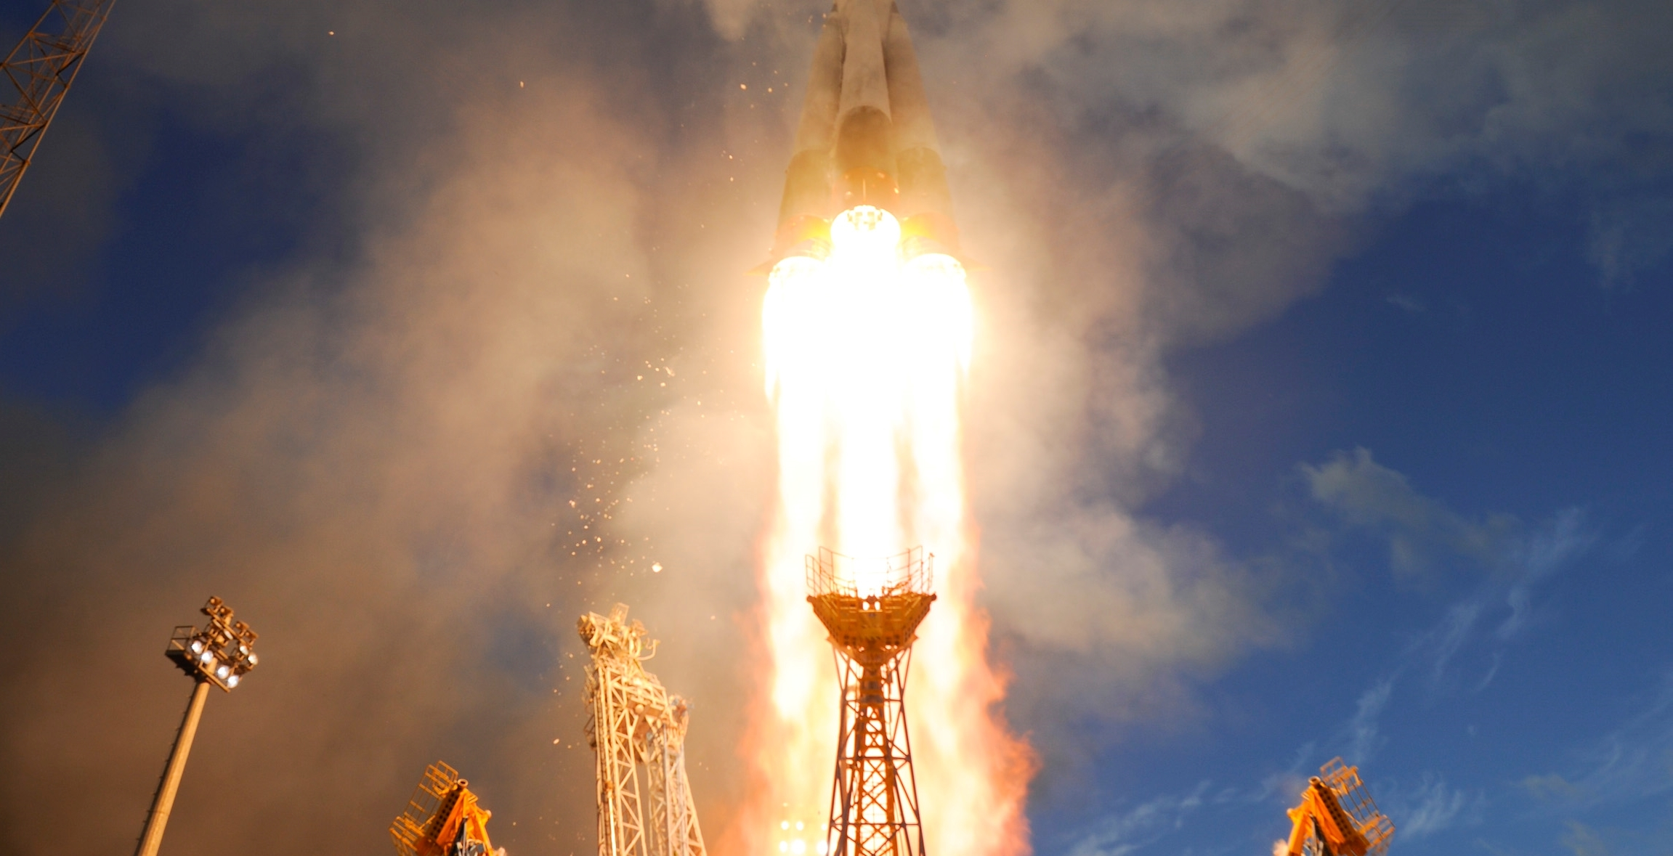
Lift off
(sort of)
Image credit: ”Sentinel-1A liftoff”, ESA–S. Corvaja, 2014
Notes:
http://www.esa.int/spaceinimages/Images/2014/04/Sentinel-1A_liftoff14. I first had an American rocket there, but then realized I’m attending ELAG. So I went with a Russian rocket with ESA payload.
How everything got started
Project’s basic idea: Instead of searching for publications, one could search for research results and data.
Project had thought, or rather had not thought of details of the database that much. ”One of the research assistants can come up with something”. Project team approached the library for consultation about the bibliographic portion of their data.
I could not resist the temptation to offer some ideas on how the database could be implemented.
At first the communication was pretty difficult. For example: Linguistics and software developers have very different ideas about concepts like classes, attributes or properties.
I met the research group, and still do, very frequently to evaluate the current version and decide about the changes.
From Excel to web, from tables to graphs
They wanted something that could become shared resource for researchers all over the world.

Slide 4

Language change database (LCD)
Part of the project ” Reassessing language change: the challenge of real time”
  Principal investigator Terttu Nevalainen
  Funded by the Academy of Finland (2014-2018)
Online resource for corpus-based research on the English language
Collaborative and cumulative
Content will be made openly available
Notes:
The project was just starting so there was no model available yet on how to describe the their research data.
We needed a system that can be used to easy terative development of the data model.

Slide 5
LCD technology
Callimachus – development environment for data driven web applications
  Everything is done in the browser
  Easy to get started, change (and make a mess)
  Key acronyms
      Javascript, RDFa, SPARQL, XSL, Xproc
  Data as RDF
  Extensive provenance information
  PURLs, REST CRUD, SPARQL
  Complies with the LDP specification (indirect container)
Notes:
Callimachus was also nice in that regrd that after every change (that took minutes) we always had a working system.
All we changed was the HTML template through which the data was inputed. Some cleaning up was involved from time to time if something was deleted, but could be done through the SPARQL endpoint.

Slide 6
LCD data
Research results
Research data
  Files
  RDF Data Cube vocabulary
Annotations
  Web annotation data model
Other entities
  SKOS vocabularies
      Grammar, variety, statistical method, genre, social category etc
  Publications
  Corpora
  People
  Time periods
Notes:
Results and related entities
Corpora
Publication
Grammar
Dialectology
Resulst are separated from the publication because we want to be able to support also other forms of scholarly communication in future.
We started the work on the datamodel from the end user’s perspective: what would the user search for? Where would that data come from?
Feedback from conference patricipants about the data model.
Soon we realized that we want to save more detailed information for research purposes.

Slide 7
LCD data example
(simplified)
<grammar/comparison>
<narrower>
<contentdetail/1>
<grammar/superlative>
<grammar>
<related>
<publication/1>
<grammar/adverbs>
<grammar>
<contentdetail/1#grammar>
<file/1>
<source>
<dataset/1>
<target>
<obs/1>
<annotation/1>
<absfreq>
<bodyText>
122^^integer
”This can’t be right?”

Slide 8
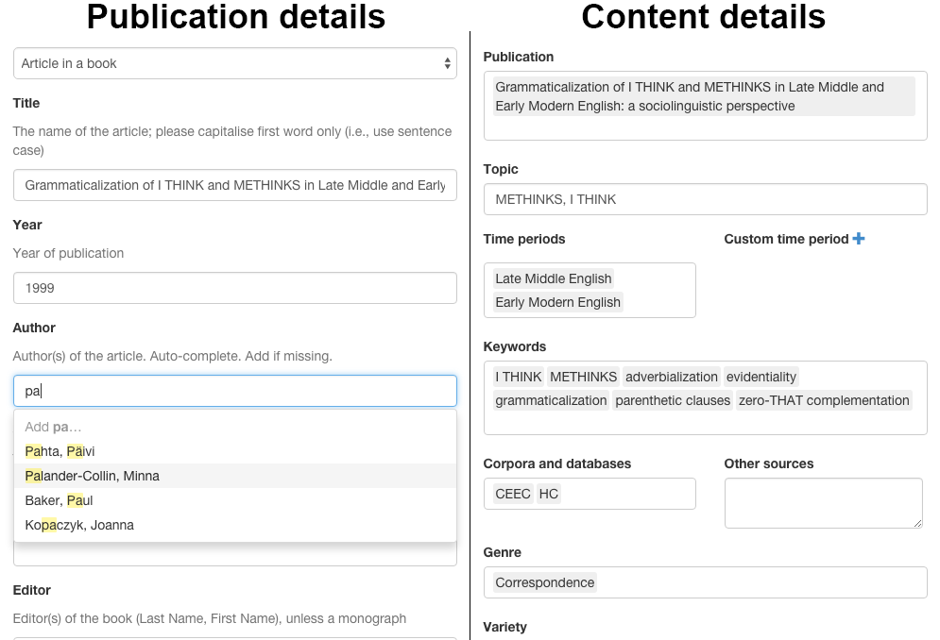
LCD UI
Notes:
UI consists of
Forms
Lists

Slide 9
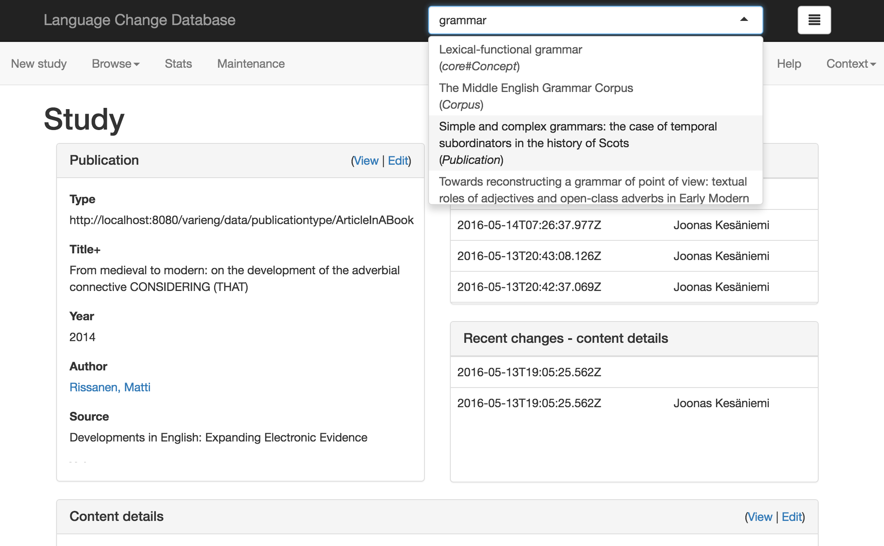
LCD UI
Notes:
UI consists of
Compound views
Entity search
Discussion about the possibilities of generalizing the implemented model.
Library of reusable javascript ja html components for copy pasting your own data management framework.
Not the sleekest solution, but it could work. It would be a compromise between the ease of development/maintenance and customizations for the task at hand.

Slide 10
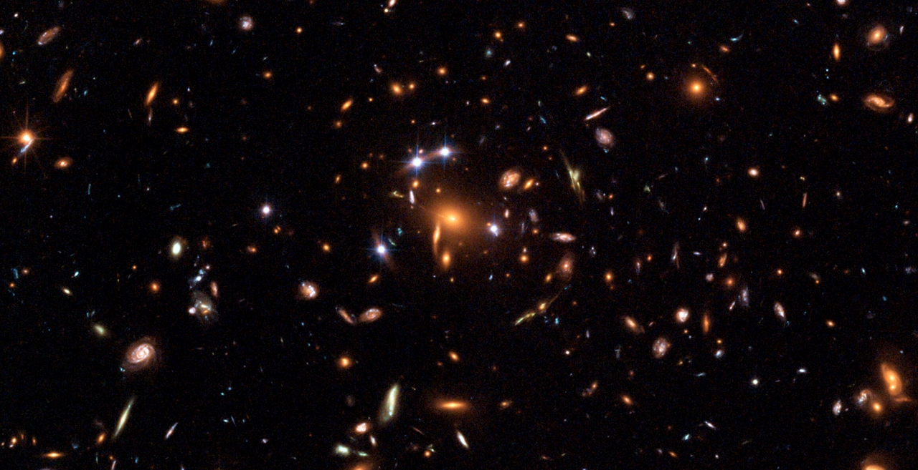
Image credit:ESA, NASA, K. Sharon (Tel Aviv University) and E. Ofek (Caltech)
Notes:
Four groups of galaxies acting as gravitational lens for quasar in the middle.
And just like galaxies, research data come is various shapes and sizes.
The ”universe” of research data is so vast that our little LCD dataset is almost impossible to spot

Slide 11
LCD
Image credit:ESA, NASA, K. Sharon (Tel Aviv University) and E. Ofek (Caltech)
Notes:
IIt is actually so small that you couldn’t even tell that is not the LCD dataset.

Slide 12
LCD
Image credit:ESA, NASA, K. Sharon (Tel Aviv University) and E. Ofek (Caltech)
Notes:
This is the LCD dataset.
I wanna Jon Oliver for that joke. Moving on. So what about the bigger picture?

Slide 13
the bigger picture
LCD
Image credit:ESA, NASA, K. Sharon (Tel Aviv University) and E. Ofek (Caltech)
Notes:
How can we make LCD part of something bigger?
And no, that is not a mistake. The first one was actually the LCD.

Slide 14
UHOD
University of Helsinki Open Data
  Making the most out of data in existing systems
  Putting identifiers to work
  Linked data acquisition, processing and distribution
Creating useful data services from already published data
  Read-only
  Public and published provenance
  Robust and scalable data APIs
  Backend data and frontend data separated
Multiple views on the same underlying RDF dataset
Notes:
Too often we have the data or we know where to get the data, but there is something missing in between.

Slide 15
UHOD & lcd
LCD
Data maintenance
Research data
Dataset description
LCD
UI
UHOD
Data reuse
Data broker

Slide 16
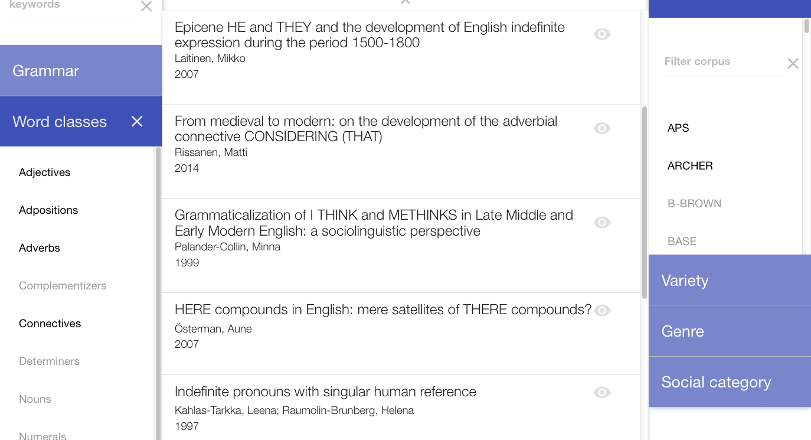
LCD ui search and retrieval
Notes:
And this is how the end-user’s UI currently looks. This is the first prototype.
Powered by the UHOD infrastructure.
Research team is already using it for checking the status of the database.

Slide 17
UHOD concept
RDM
CRIS
UHOD
ILS
IR

Slide 18
UHOD concept
<orgunit>
<subject1>
<publication/ethesis1>
<publication/cris1>
<publication/book1>
<datasetDescription>
<dataset>
Notes:
And the nice thing is that the connection between datasetdescription and publication can come from any of systems.
If the CRIS is not up to the task of linking datasets to publications. No worries, LCD can be use to add publication identifiers
Referring the Karen Coyle’s talk yesterday, we could use any system (another callimachus, SMW, excell files whatever) to maintain more ”creative” relationships to any resources.

Slide 19
Uhod concept
Application1
Application2
Service 1
Service 2
Service 3
Frontend RDF data
Backend RDF data
Notes:
Let’s say for example that somebody wants to use the grammar concepts from LCD in their own application (auto-complete).
The average web developer is not going to use SPARQL endpoint. He or she just wants an URL to call from the autocomplete component.
This could actually be implemented using the same service as the LCD enduser UI, but it could also be another data service, dedicated to that particular use case.
How this can implemented efficiently is another story, I will come to it shortly.

Slide 20
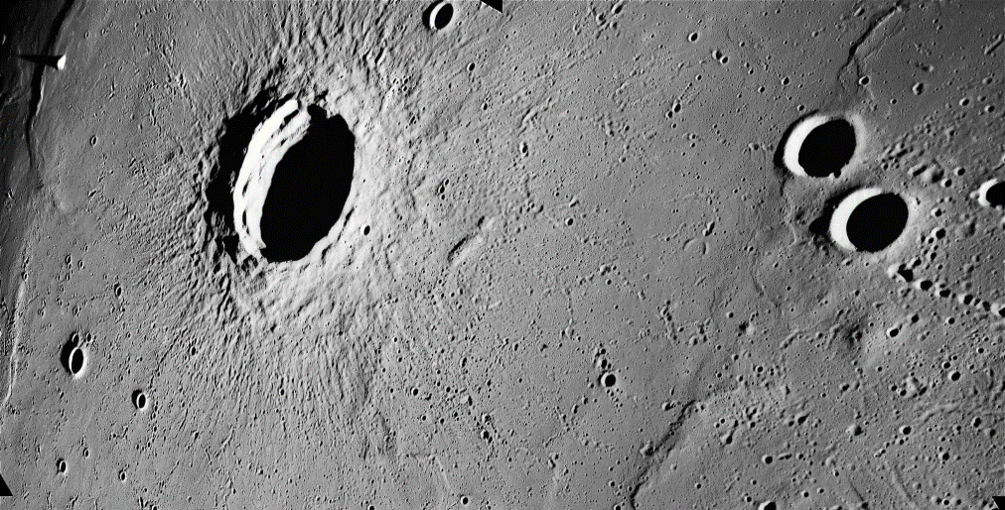
What about impact?
Image credit: NASA/JSC/Arizona State University
Notes:
Scientific impact – Too soon to say.
LCD is growing. Usage will soon expand beyond the research group.

Slide 21
Impact on the library
Active participant in research activities
  Publications
  Conferences
Data provider
  Visualizations based on CRIS data
  University website’s search functionality
New funding
  ATTX project 2016-2017
  Developing tools for putting linked data to work in a easy to use, robust and scalable manner
  Implementation for the next version of UHOD
Notes:
Not just the collaboration with the research group, but the library as the trusted provider of data services.
For example CRIS. They have the data, but they need help in adding the approriate links and exporting it out with certain aggregations and in a certain format.
Scientific conferences and other, like ELAG
Related to the national Open Science and Research initiative.
ATTX is an interesting project that is goiing to be dealing with research related data and it will take the ideas behind UHOD concept to level by creating software for cloud deployed, container based data service infrastructure. But that is topic for another time, maybe in another conference. Who knows?

Slide 22

Thank you
Image credit: NASA/Bill Ingalls

